Slide 1
Big Data 101
Introduction to Hadoop & Machine Learning

Slide 2
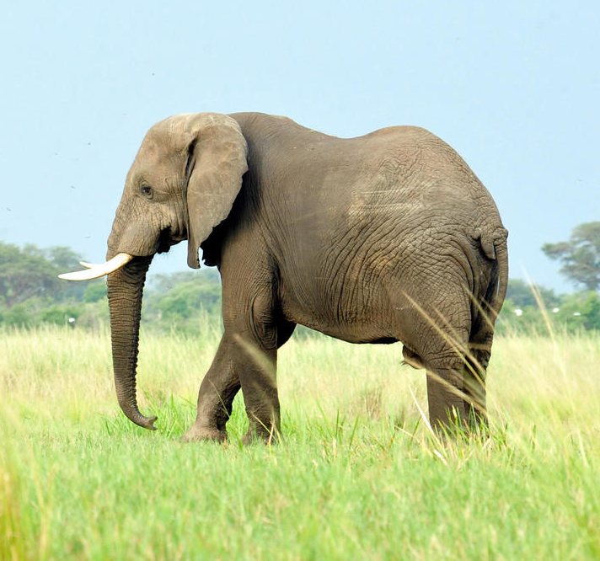
Hello!
I am Craig Covey
Data Analyst @ Concho
You can find me on LinkedIn @ www.linkedin.com/in/craigcovey7

Slide 3
Data Science
Hadoop
Big Data
SQL
Regression
Velocity
Statistics
Unstructured Data
Scala
Variety
Storage
Algorithms
Cloudera
Database
Python
NoSQL
Streaming Data
Volume
Data Mining
Machine Learning
R
Prediction
Data Analysis
Search
HDFS
Model
Distributed Computing

Slide 4
Big Data is a Problem!
Not a solution

Slide 5
The Three V’s of Big Data
Volume
Velocity
Variety

Slide 6
Data Velocity
Big Data: expanding on 3 fronts
Real Time
Near Real Time
Periodic
Batch
MB
GB
TB
PB
Data Volume
Table
PDF
Database
Social
Images
Docs
Video
Data Variety
IoT

Slide 7
Most Popular Solution to Big Data? …
1
A technology called Hadoop

Slide 8
What is Hadoop?
Hadoop is an open source framework for distributed processing of large data sets across clusters of many commodity computers

Slide 9
What is Hadoop?
Open Source
Distributed File System
Distributed Computing
Scales with Data
¢
On Non-Expensive Servers

Slide 10
Hadoop Distributed File System (HDFS)
Small bits of data can be processed more quickly than large whole files
Data is broken into small pieces and and spread throughout the cluster
A “Cluster” is a collection of servers (nodes) linked together

Slide 11
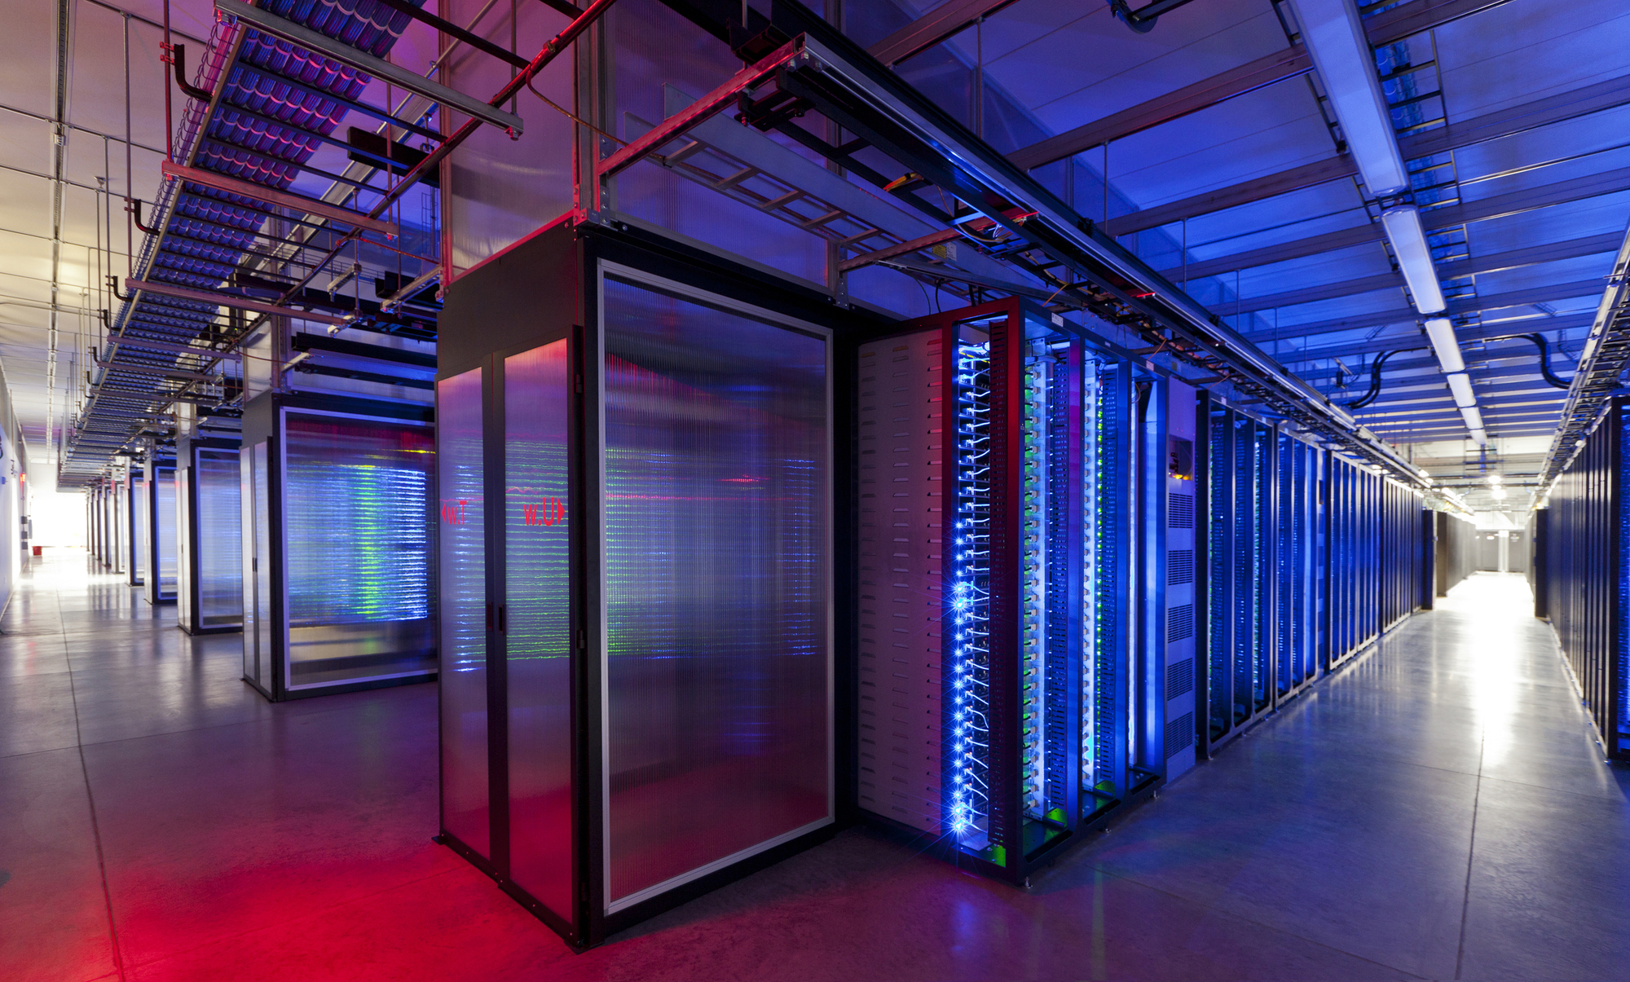
Distributed processing moves the processing software to the data, rather than move the data to the software
Distributed Processing and Computing
Each node in the cluster has a storage layer and a processing layer
Node 1
Node 2
…
Node n
Processing Layer
Storage Layer

Slide 12





Top Big Data Vendors
Source: https://www.linkedin.com/pulse/big-data-who-best-hadoop-vendors-2017-bernard-marr

Slide 13
What is Machine Learning?
2
…

Slide 14
Machine Learning is …
Quotations are commonly printed as a means of inspiration and to invoke philosophical thoughts from the reader.

Slide 15
Transition headline
1
Let’s start with the first set of slides

Slide 16
Quotations are commonly printed as a means of inspiration and to invoke philosophical thoughts from the reader.

Slide 17
This is a slide title
Here you have a list of items
And some text
But remember not to overload your slides with content
Your audience will listen to you or read the content, but won’t do both.

Slide 18
You can also split your content
White
Is the color of milk and fresh snow, the color produced by the combination of all the colors of the visible spectrum.
Black
Is the color of coal, ebony, and of outer space. It is the darkest color, the result of the absence of or complete absorption of light.

Slide 19
In two or three columns
Yellow
Is the color of gold, butter and ripe lemons. In the spectrum of visible light, yellow is found between green and orange.
Blue
Is the colour of the clear sky and the deep sea. It is located between violet and green on the optical spectrum.
Red
Is the color of blood, and because of this it has historically been associated with sacrifice, danger and courage.

Slide 20
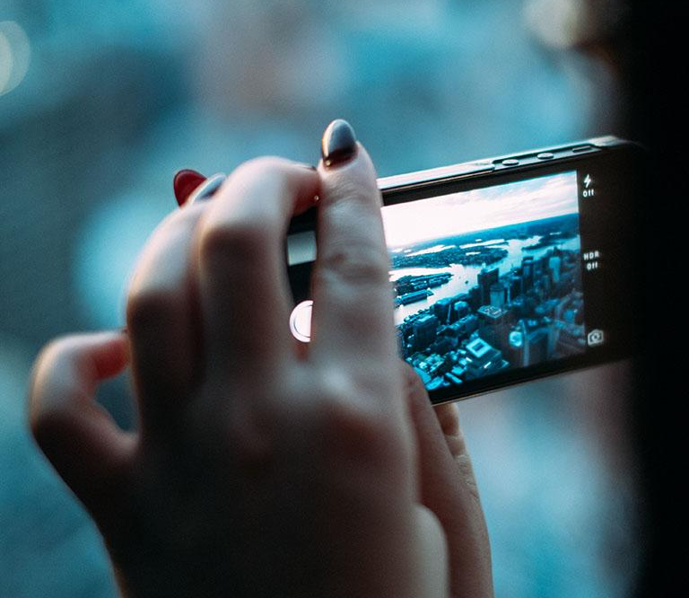
A picture is worth a thousand words
A complex idea can be conveyed with just a single still image, namely making it possible to absorb large amounts of data quickly.

Slide 21
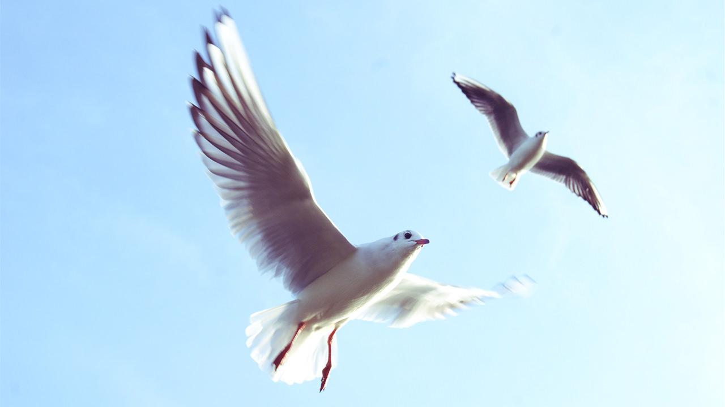
Want big impact?
Use big image.

Slide 22
Use charts to explain your ideas
White
Gray
Black

Slide 23
And tables to compare data
 | A | B | C
Yellow | 10 | 20 | 7
Blue | 30 | 15 | 10
Orange | 5 | 24 | 16

Slide 24
Maps
our office

Slide 25
89,526,124
Whoa! That’s a big number, aren’t you proud?

Slide 26
89,526,124$
185,244 users
100%
That’s a lot of money
And a lot of users
Total success!

Slide 27
Our process is easy
first
second
last

Slide 28
Our sales funnel
20%
40%
60%
80%
Diagram featured by http://slidemodel.com
100%

Slide 29
Let’s review some concepts
Yellow
Is the color of gold, butter and ripe lemons. In the spectrum of visible light, yellow is found between green and orange.
Blue
Is the colour of the clear sky and the deep sea. It is located between violet and green on the optical spectrum.
Red
Is the color of blood, and because of this it has historically been associated with sacrifice, danger and courage.
Yellow
Is the color of gold, butter and ripe lemons. In the spectrum of visible light, yellow is found between green and orange.
Blue
Is the colour of the clear sky and the deep sea. It is located between violet and green on the optical spectrum.
Red
Is the color of blood, and because of this it has historically been associated with sacrifice, danger and courage.

Slide 30
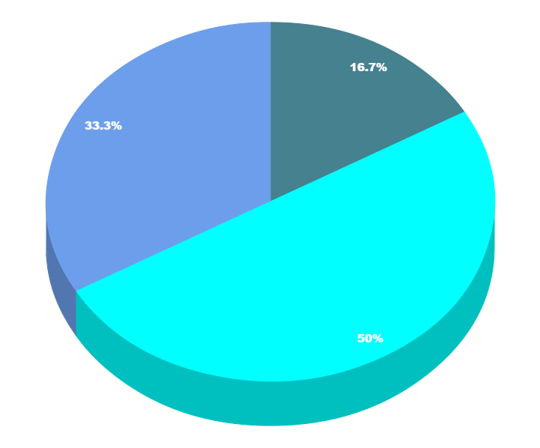
You can copy&paste graphs from Google Sheets

Slide 31
Place your screenshot here
Android project
Show and explain your web, app or software projects using these gadget templates.

Slide 32
Place your screenshot here
iPhone project
Show and explain your web, app or software projects using these gadget templates.

Slide 33
Place your screenshot here
Tablet project
Show and explain your web, app or software projects using these gadget templates.

Slide 34
Place your screenshot here
Desktop project
Show and explain your web, app or software projects using these gadget templates.

Slide 35
Thanks!
Any questions?
You can find me at:
@username
user@mail.me

Slide 36
Credits
Special thanks to all the people who made and released these awesome resources for free:
Presentation template by SlidesCarnival
Photographs by Unsplash

Slide 37

Presentation design
This presentation uses the following typographies and colors:
Titles: Nixie One
Body copy: Muli
You can download the fonts on this page:
http://www.google.com/fonts#UsePlace:use/Collection:Nixie+One|Muli:300,400,300italic,400italic
Click on the “arrow button” that appears on the top right
Aquamarina #00e1c6 / Turquoise #19bbd5 / Skyblue #2c9dde /
Light gray #c6daec / Dark blue #0e293c
You don’t need to keep this slide in your presentation. It’s only here to serve you as a design guide if you need to create new slides or download the fonts to edit the presentation in PowerPoint®

Slide 38
SlidesCarnival icons are editable shapes.
This means that you can:
Resize them without losing quality.
Change fill color and opacity.
Change line color, width and style.
Isn’t that nice? :)
Examples:

Slide 39
SlidesCarnival icons are editable shapes.
This means that you can:
Resize them without losing quality.
Change fill color and opacity.
Change line color, width and style.
Isn’t that nice? :)
Examples:

Slide 40
😉
Now you can use any emoji as an icon!
And of course it resizes without losing quality and you can change the color.
How? Follow Google instructions https://twitter.com/googledocs/status/730087240156643328
✋👆👉👍👤👦👧👨👩👪💃🏃💑❤😂😉😋😒😭👶😸🐟🍒🍔💣📌📖🔨🎃🎈🎨🏈🏰🌏🔌🔑 and many more...

